Slide 1
Factors of Performance: CPU Execution Time, CPI, Clock Cycles, and Benchmarking
CSA1220- COMPUTER ARCHITECTURE
TECHNICAL PRESENTATION
Guided by:
Dr. S.RADHIKA
Presented by:
J. LAKSHMI DEVI
(192524300)

Slide 2
Introduction
What is Computer Performance?
Performance measures how quickly a computer executes programs.
Faster execution improves user experience.
Performance depends on processor speed and architecture.
Important in mobile devices, gaming, AI, and cloud computing.

Slide 3
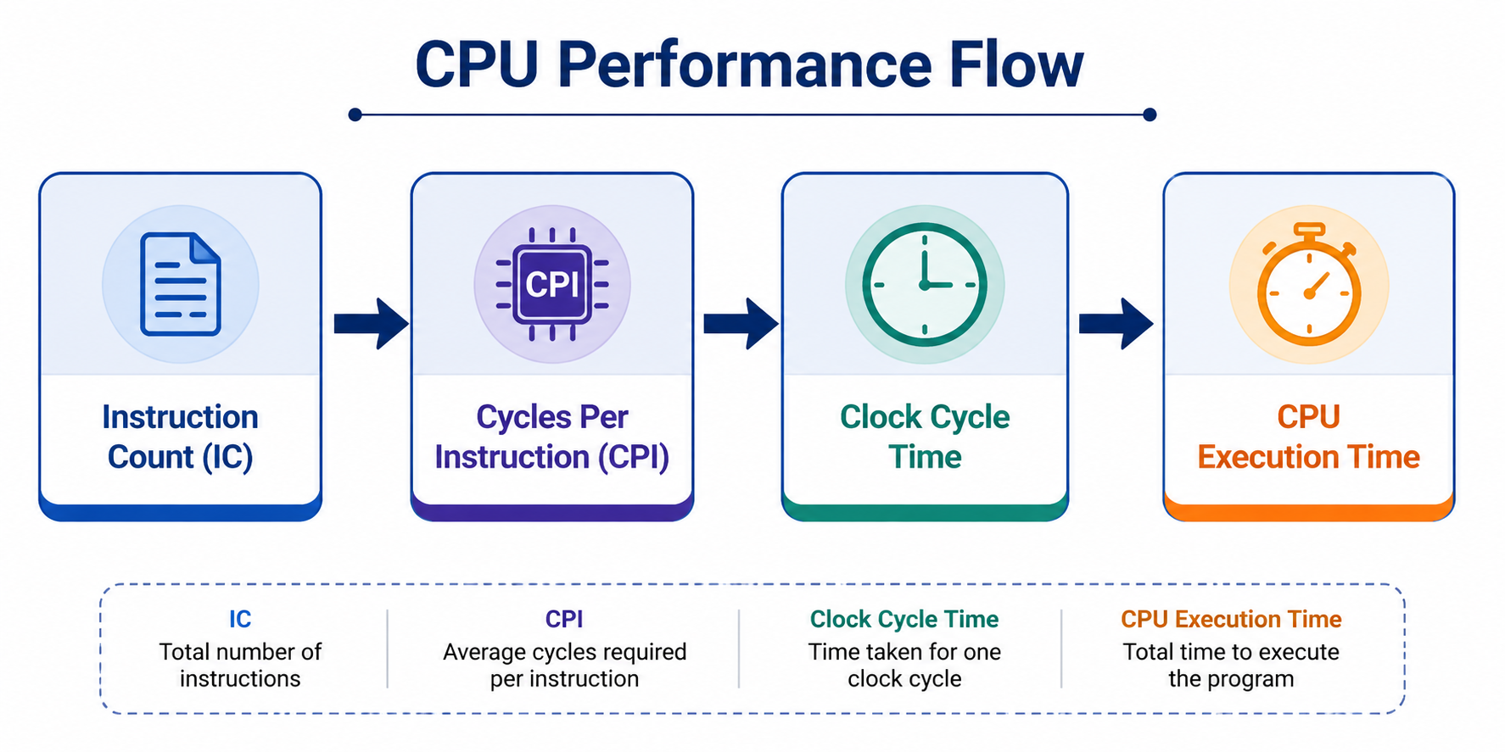

Performance Metrics
Key Performance Parameters
CPU Execution Time
Clock Cycle Time
Clock Rate (Frequency)
CPI (Cycles Per Instruction)
Instruction Count (IC)
Formula:
$\text{CPU} \text{Time}=\text{Instruction} \text{Count}×\text{CPI}×\text{Clock} \text{Cycle} \text{Time}$

Slide 4

CPU Execution Time
CPU Execution Time
Formula:
$CPU Time=\frac{Instruction Count×CPI}{Clock Rate}$
Example:
IC = 5 Million
CPI = 2
Clock Rate = 2 GHz
Result:
CPU Time = 5 ms

Slide 5
CPI and Clock Cycles
Cycles Per Instruction (CPI)
CPI represents average clock cycles required for one instruction.
Lower CPI means better performance.
Depends on instruction complexity.
Example Table
Processor | CPI
ARM Cortex | 1.2
Intel Core | 1.0
AMD Ryzen | 0.9

Slide 6
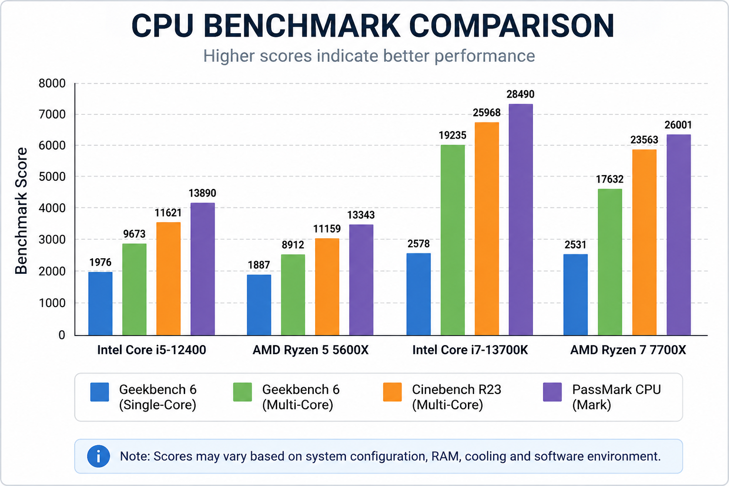
Benchmarking
Purpose
Compare processor performance.
Measure execution speed.
Evaluate efficiency.
Common Benchmarks
SPEC CPU
Geekbench
Cinebench
PassMark

Slide 7
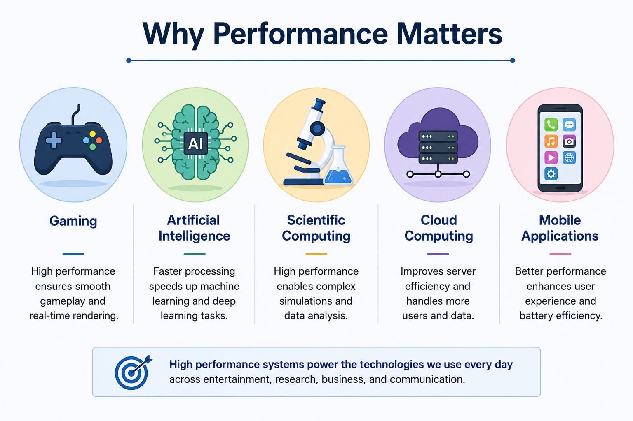
Real-World Applications
Why Performance Matters
Gaming
Artificial Intelligence
Scientific Computing
Cloud Computing
Mobile Applications

Slide 8
Advantages and Limitations
Advantages
Helps choose efficient processors.
Improves system performance.
Reduces execution time.
Optimizes hardware design.
Limitations
Performance varies with workload.
Higher clock speed increases power consumption.
Benchmarks may not represent every application.

Slide 9
Conclusion
CPU performance depends on IC, CPI, and clock rate.
Benchmarking helps compare processors objectively.
Understanding performance metrics helps design faster and efficient computer systems.
Modern processors balance speed, power, and efficiency.

Slide 10
THANK YOU

